Slide 1





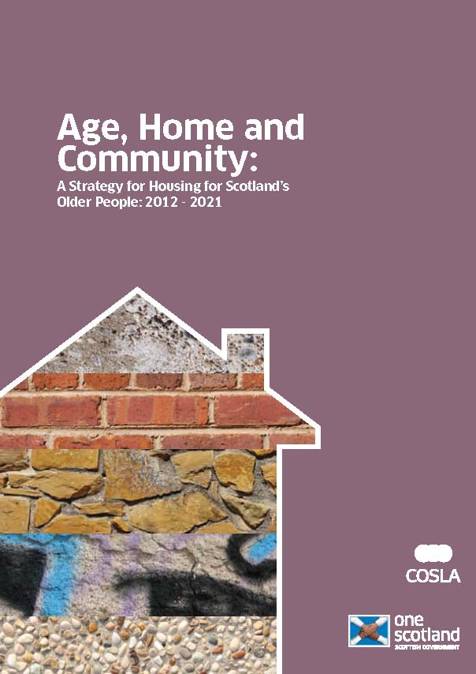


How can we learn from each other in England, Scotland and Wales?
Professor Judith Phillips
Dr Vikki McCall

Slide 2
Housing and Ageing – where are we now?
Notes:
VIKKI

Slide 3
Are we prepared?
The UK housing sector is ‘woefully underprepared’ for ageing (Lords Select Committee 2013, UK Parliament 2017), which makes housing and ageing an important policy priority.
Alongside the UK Government’s Housing Strategy, the devolved governments have several strategies that link to housing and older people in Scotland (Age, Home and Community: 2012 – 2021) and Wales (Strategy for Older People 2013-2023).
Policy review groups emphasise an urgent need to focus on the implementation phase and possibilities for collaboration (Our Housing AGEnda 2017).
Notes:
VIKKI

Slide 4
Ageing-in-place
Ageing-in-place has been a key theoretical and policy driver in recent years (Sixsmith and Sixsmith 2008; Sixsmith et al. 2017).
This agenda stipulates that the preferred environment in which to age is at home and in the community. In achieving this, housing supports are needed that encourage older adults to live independently, co-located in a community of choice and surrounded by services and amenities that meet the often complex and changing requirements of old age (Woolrych and Sixsmith 2017; Greasley-Adams, Gibson, Robertson and McCall 2017).
Notes:
VIKKI

Slide 5
An extensive review of research by the Housing and Dementia Research Consortium (2009) points to the benefits of a lifestyle that offers the dignity and sense of wellbeing that older people seek, based on three key principles:
Independence
Empowerment
Accessibility
Notes:
VIKKI

Slide 6
Trans-disciplinary approach
We take a transdisciplinary approach as this is about “the cooperative creation of a consensus” (Boger et al. 2016) to build a set of recommendations to support policy and practice in Housing and Ageing for Scotland 2030…
… this will help us gain new perspectives through our “joint efforts” by enhancing the ability to tackle real world problems (Boger et al. 2016).
Notes:
VIKKI

Slide 7
Let’s make positive change
Bringing together issues around Housing and Ageing, as well as people from housing, health and social care sectors lets us mobilise a diverse team of researchers, knowledge creators and users that will go beyond common boundaries.
Notes:
VIKKI

Slide 8
How do we learn from each other?
Notes:
JUDITH

Slide 12
Thank you for taking part and enjoy the day!

